Slide 1
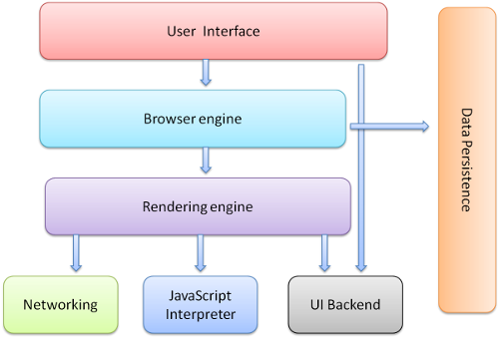
Browser Architecture

Slide 2
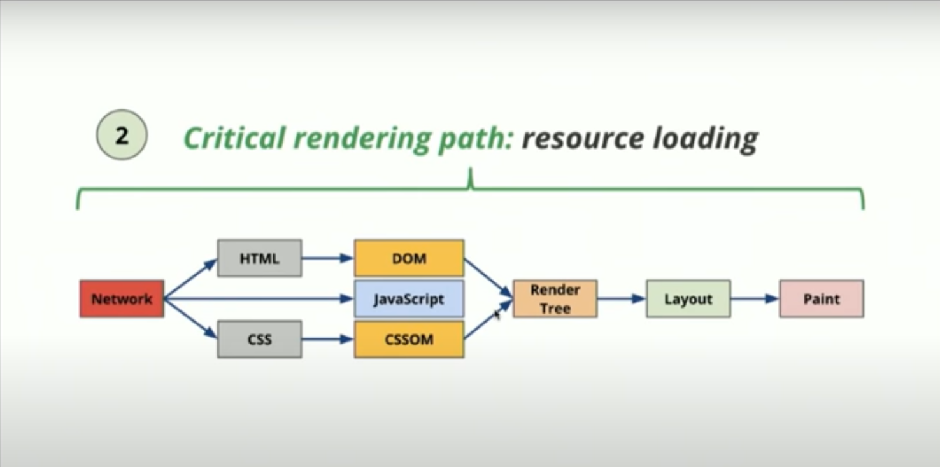
Critical Rendering Path

Slide 3
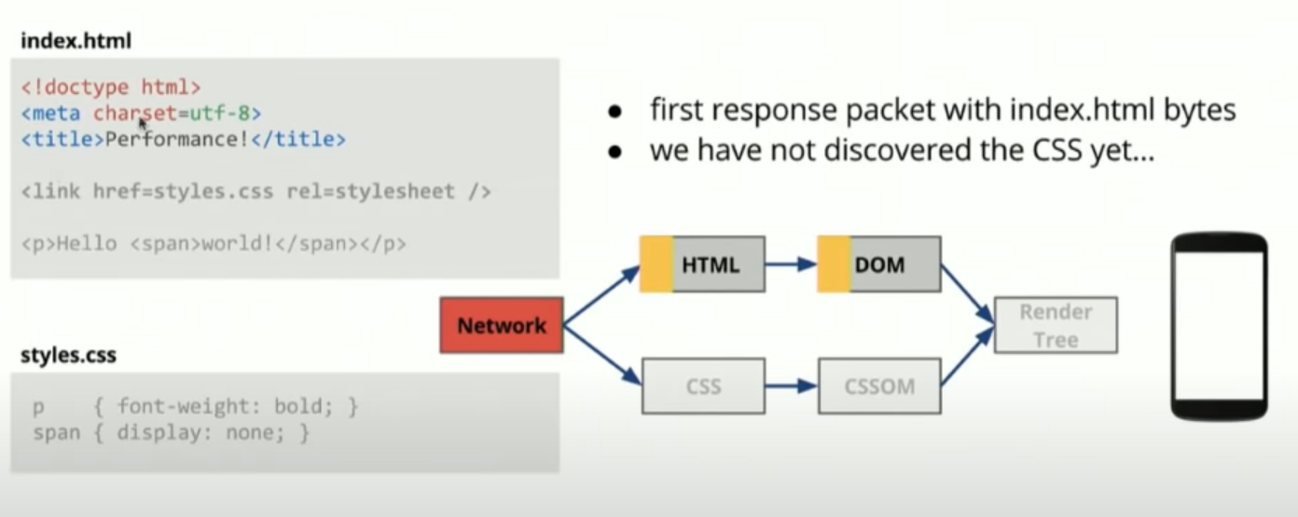
HTML Parsing

Slide 4
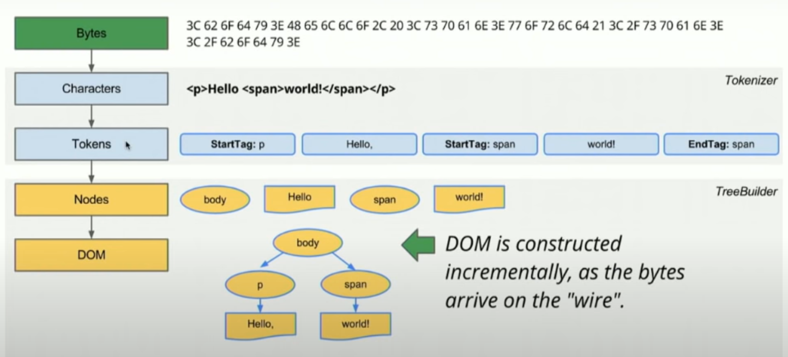
HTML Parsing

Slide 5
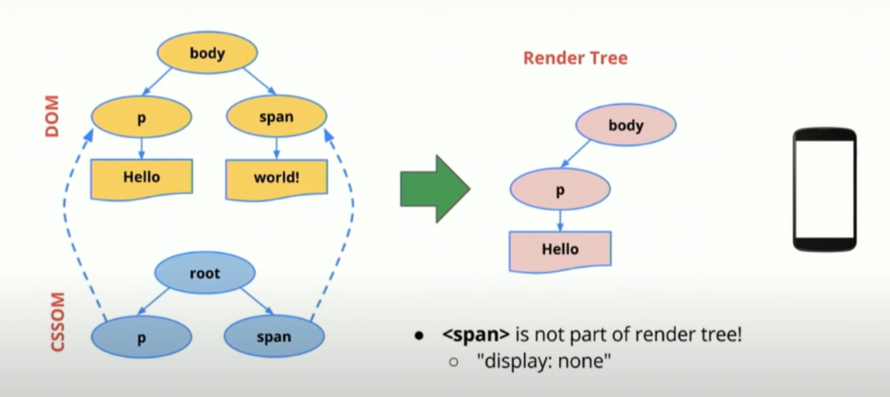
DOM + CSSOM = Render Tree

Slide 6
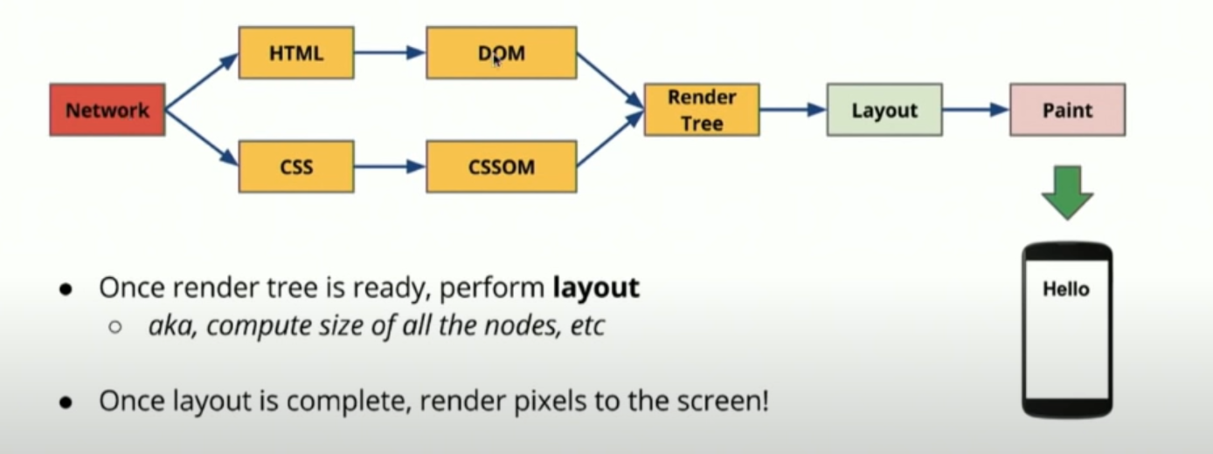

Slide 7
What is Shadow DOM?
To keep the markup structure, style, and behavior hidden and separate from other code on the page so that different parts do not clash, and the code can be kept nice and clean.
The Shadow DOM API is a key part of this, providing a way to attach a hidden separated DOM to an element

Slide 8
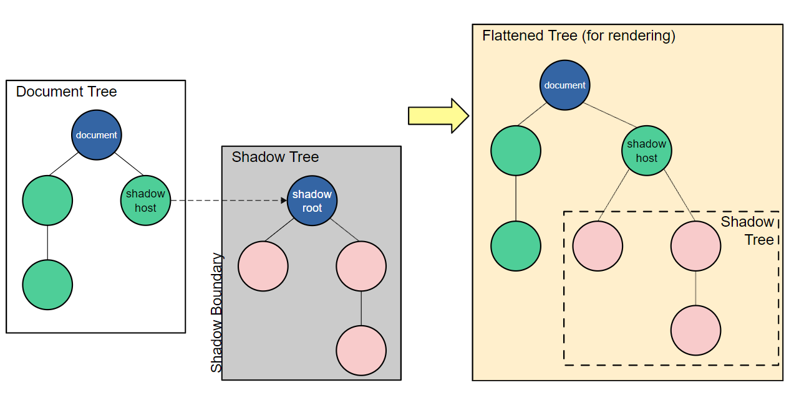
Shadow DOM allows hidden DOM trees to be attached to elements in the regular DOM tree — this shadow DOM tree starts with a shadow root, underneath which can be attached to any elements you want, in the same way as the normal DOM.
Notes:
<!DOCTYPE html>
<html>
<head>
<meta charset="utf-8">
<script>
class MyAwesomeComponent extends HTMLElement {
constructor() {
super();
const shadowRoot = this.attachShadow({mode: 'open'});
shadowRoot.innerHTML = `
<!-- this styling is scoped to the element! -->
<style>h1 { color: red; }</style>
<h1>Greetings from the dark side of the DOM</h1>
`;
}
}
customElements.define('my-awesome-component', MyAwesomeComponent);
</script>
</head>
<body>
<my-awesome-component></my-awesome-component>
</body>
</html>

Slide 9
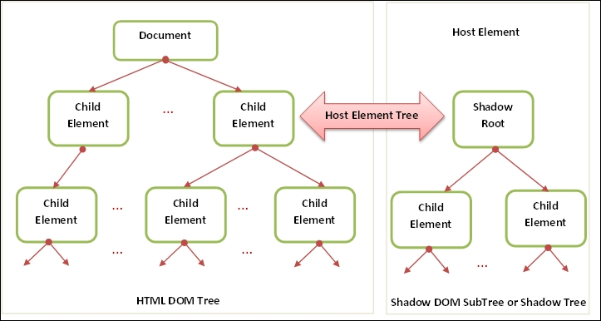

Slide 10
What is Virtual DOM?
The virtual DOM (VDOM) is a programming concept where an ideal, or “virtual”, representation of a UI is kept in memory and synced with the “real” DOM by a library such as ReactDOM. This process is called reconciliation.

Slide 11
